Slide 1

Story Text Generation using RNN, LSTM, and GRU Models
DRIVING INNOVATION THROUGH COLLABORATION

Slide 2

Introduction
The task of generating coherent and meaningful text automatically is a major challenge
Sequence models like RNN, LSTM, and GRU are effective for learning patterns from sequential data.
This project explores and compares the ability of these models to generate creative stories.

Slide 3
Problem Statement
Traditional text generation lacks context understanding, leading to incoherent sentences.
Need for models that can capture long-term dependencies and generate natural-sounding stories.
Objective:
➔ Compare how RNN, LSTM, and GRU perform on text generation

Slide 4

PROCESS
Text Preprocessing
➔ Tokenization, character-level vocabulary creation.
Model Building
➔ Three separate models:
Simple RNN
LSTM
GRU
Training
➔ Using input sequences to predict next characters.
Text Generation
➔ Feeding a seed text to generate new story lines.

Slide 5
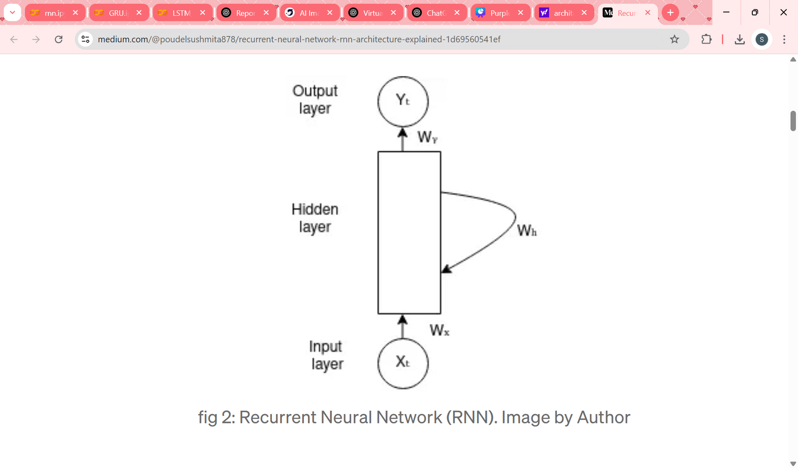
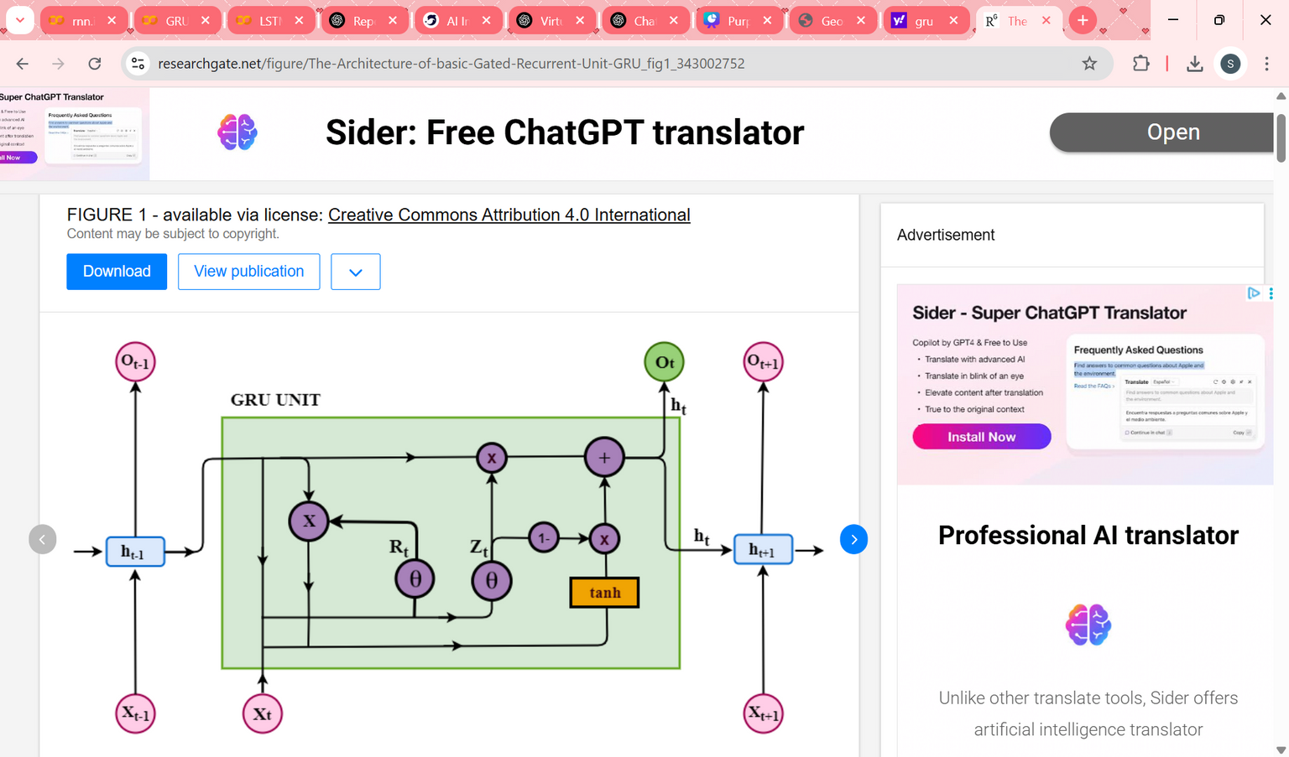
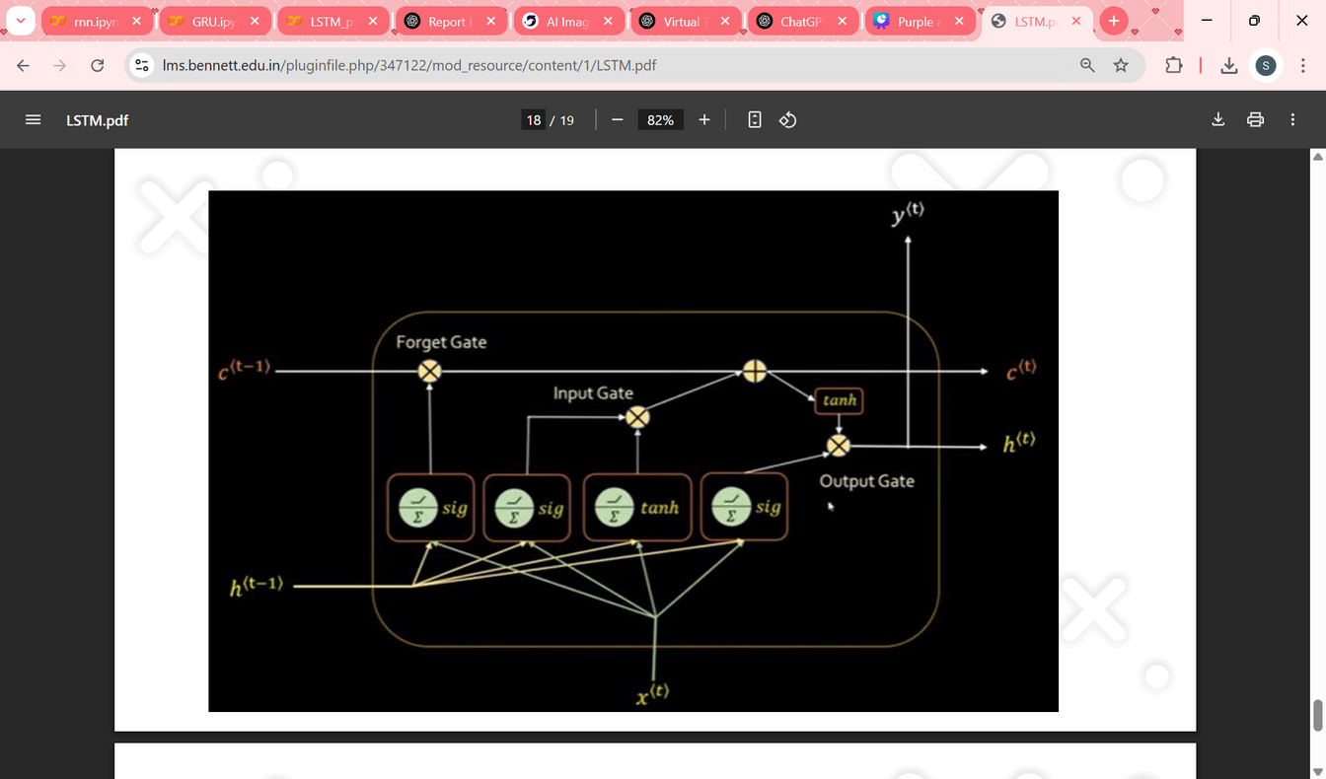
ARCHITECTURE DIAGRAM
GRU
RNN
LSTM

Slide 6

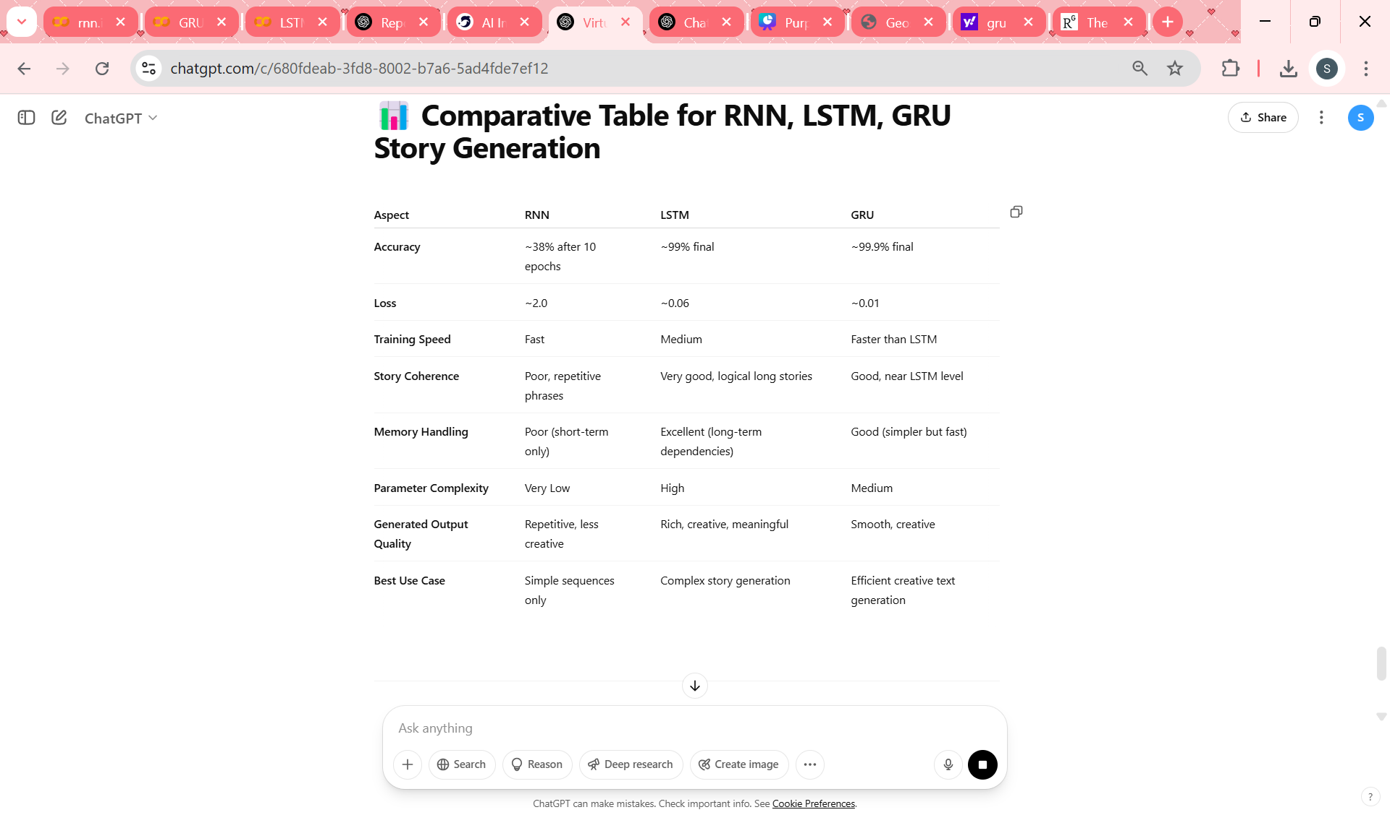
Comparative Table for RNN, LSTM, GRU

Slide 7

conclusion
RNN: Limited accuracy and memory, with poor story quality. Suitable only for simple tasks.
LSTM: Excellent at long-term memory, generating coherent, high-quality stories. Best for detailed, creative writing but computationally complex.
GRU: Similar to LSTM in performance but faster and less complex, offering a good balance for creative tasks.

Slide 8

Thank you

